Slide 1

Exploratory Data Analysis
G2M insight for Cab Investment firm
21-Apr-2024

Slide 2
Problem Statement
XYZ is a private equity firm in US. Due to remarkable growth in the Cab Industry in last few years and multiple key players in the market, it is planning for an investment in Cab industry.
Objective : Provide actionable insights to help XYZ firm in identifying the right company for making investment.
The analysis has been divided into four parts:
Data Understanding and Exploration
Profitability Analysis
Market Positioning and Competitive Analysis
Recommendations for investment

Slide 3
Data Exploration
18 Features( including 1 derived feature)
Timeframe of the data: 2016-01-31 to 2018-12-31
Total data points :359,393
Assumptions:
Outliers are present in Price_Charged feature but due to unavailability of trip duration details ,we are not treating this as outlier.
Profit of rides are calculated keeping other factors constant and only Price_Charged and Cost_of_Trip features used to calculate profit.
Users feature of city dataset is treated as number of cab users in the city.We have assumed that this can be other cab users as well(including Yellow and Pink cab)

Slide 4
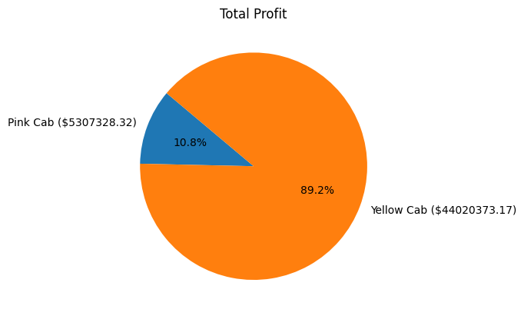
Total Profit Analysis
Profit Analysis

Slide 5
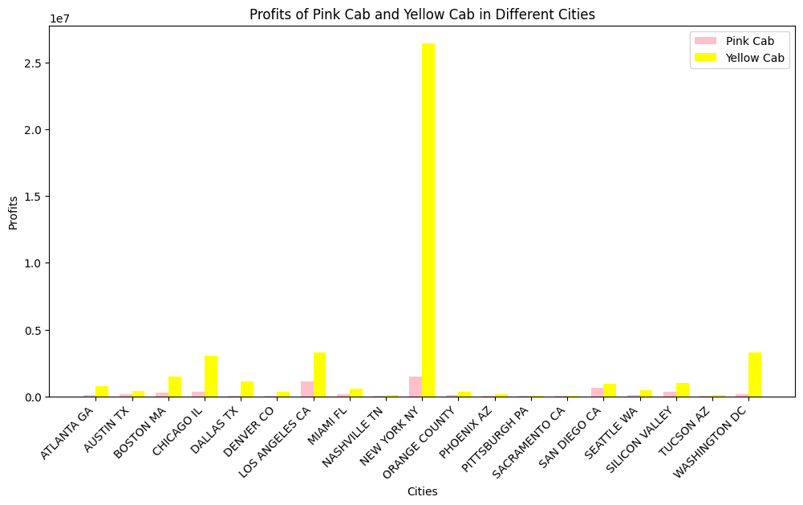
City Wise Profit Analysis
Yellow Cab outperforms Pink Cab across multiple cities, with significantly higher profits.
For instance, in New York, Yellow Cab's profits ($26,451,080.77) dwarf Pink Cab's ($1,511,474.39).
Similarly, in Chicago, Yellow Cab's profits ($3,068,590.93) far exceed Pink Cab's ($318,722.49).
Given these substantial differences in profitability, investing in Yellow Cab
presents a more lucrative opportunity
for XYZ firm.

Slide 6
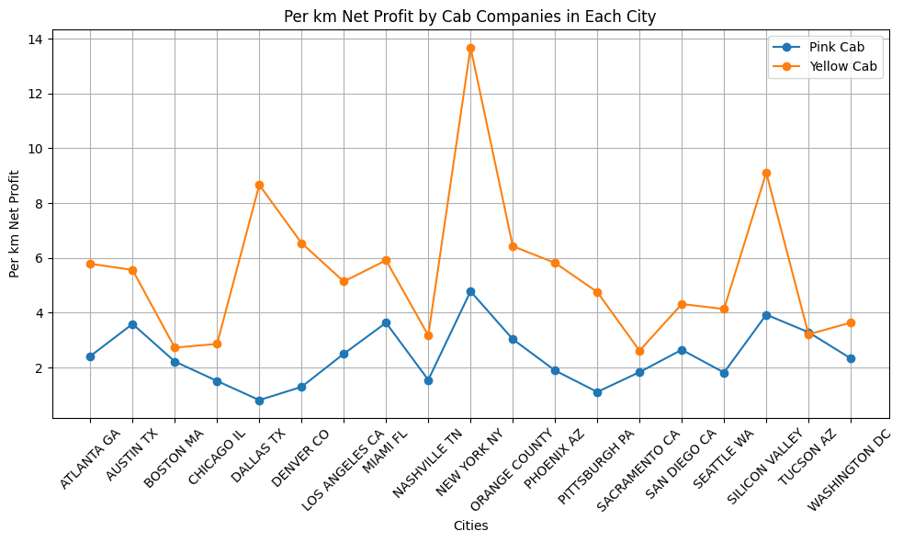
Per Kilometer Average Net Profit Analysis

Slide 7
City wise Ride Analysis: Average Metrics and Earnings
Breakdown
1. Pink Cab Data | 1. Pink Cab Data | 1. Pink Cab Data | 1. Pink Cab Data | 1. Pink Cab Data | 1. Pink Cab Data | 1. Pink Cab Data | 1. Pink Cab Data
Cities | Avg KM | Avg Price | Avg Cost | Per KM Price | Per KM Cost | Total Num of Rides | Per KM Avg Net Profit
ATLANTA GA | 22.539824 | 302.131555 | 247.619594 | 13.404344 | 10.985871 | 1762 | 2.418473
AUSTIN TX | 21.969176 | 320.435070 | 241.502901 | 14.585667 | 10.992807 | 1868 | 3.592860
BOSTON MA | 22.740746 | 300.551489 | 250.030529 | 13.216430 | 10.994825 | 5186 | 2.221605
CHICAGO IL | 22.511070 | 281.613731 | 247.565821 | 12.510011 | 10.997514 | 9361 | 1.512496
DALLAS TX | 22.021203 | 260.025652 | 242.105281 | 11.807968 | 10.994190 | 1380 | 0.813778
DENVER CO | 22.459218 | 276.202453 | 247.088437 | 12.297955 | 11.001649 | 1394 | 1.296306
LOS ANGELES CA | 22.635629 | 305.624252 | 248.955132 | 13.501911 | 10.998375 | 19865 | 2.503536
MIAMI FL | 22.299925 | 326.006309 | 244.936783 | 14.619166 | 10.983749 | 2002 | 3.635417
NASHVILLE TN | 22.528066 | 282.062493 | 247.144224 | 12.520493 | 10.970503 | 1841 | 1.549990

Slide 8
Cities | Avg KM | Avg Price | Avg Cost | Per KM Price | Per KM Cost | Total Num of Rides | Per KM Avg Net Profit
NEW YORK NY | 22.622415 | 357.074129 | 248.856589 | 15.784085 | 11.000443 | 13967 | 4.783642
ORANGE COUNTY | 22.213153 | 312.026874 | 244.613898 | 14.046942 | 11.012120 | 1513 | 3.034823
PHOENIX AZ | 21.747384 | 280.321458 | 239.121928 | 12.889893 | 10.995434 | 864 | 1.894459
PITTSBURGH PA | 22.581613 | 273.879355 | 248.794695 | 12.128423 | 11.017579 | 682 | 1.110844
SACRAMENTO CA | 22.604303 | 290.110810 | 248.638537 | 12.834318 | 10.999611 | 1334 | 1.834707
SAN DIEGO CA | 22.554710 | 307.938193 | 248.165914 | 13.652944 | 11.002842 | 10672 | 2.650102
SEATTLE WA | 22.694133 | 291.223898 | 249.942297 | 12.832564 | 11.013521 | 2732 | 1.819043
SILICON VALLEY | 22.791838 | 340.377008 | 250.766650 | 14.934162 | 11.002476 | 3797 | 3.931686
TUCSON AZ | 22.556909 | 323.213554 | 249.008830 | 14.328805 | 11.039138 | 799 | 3.289667

Slide 9
City wise Ride Analysis: Average Metrics and Earnings
Breakdown
2. Yellow Cab Data | 1. Yellow Cab Data | 1. Yellow Cab Data | 1. Yellow Cab Data | 1. Yellow Cab Data | 1. Yellow Cab Data | 1. Yellow Cab Data | 1. Yellow Cab Data
Cities | Avg KM | Avg Price | Avg Cost | Per KM Price | Per KM Cost | Total Num of Rides | Per KM Avg Net Profit
ATLANTA GA | 22.248247 | 422.413446 | 293.615723 | 18.986370 | 13.197252 | 5795 | 5.789118
AUSTIN TX | 22.512840 | 422.248940 | 296.999358 | 18.755916 | 13.192443 | 3028 | 5.563473
BOSTON MA | 22.543649 | 359.140431 | 297.656812 | 15.930891 | 13.203577 | 24506 | 2.727314
CHICAGO IL | 22.659493 | 364.021927 | 299.097441 | 16.064875 | 13.199653 | 47264 | 2.865222
DALLAS TX | 22.599395 | 493.807790 | 297.958374 | 21.850487 | 13.184352 | 5637 | 8.666135
DENVER CO | 22.444097 | 443.235413 | 296.382238 | 19.748418 | 13.205354 | 2431 | 6.543065
LOS ANGELES CA | 22.688117 | 416.231136 | 299.574768 | 18.345777 | 13.204038 | 28168 | 5.141739
MIAMI FL | 22.635606 | 432.944872 | 299.072443 | 19.126718 | 13.212478 | 4452 | 5.914241
NASHVILLE TN | 22.968837 | 376.245577 | 303.321981 | 16.380698 | 13.205805 | 1169 | 3.174893

Slide 10
Cities | Avg KM | Avg Price | Avg Cost | Per KM Price | Per KM Cost | Total Num of Rides | Per KM Avg Net Profit
NEW YORK NY | 22.496362 | 604.841911 | 296.977659 | 26.886209 | 13.201141 | 85918 | 13.685068
ORANGE COUNTY | 22.364597 | 438.548623 | 294.763268 | 19.609055 | 13.179905 | 2469 | 6.429150
PHOENIX AZ | 22.529450 | 428.737417 | 297.617010 | 19.030088 | 13.210132 | 1200 | 5.819956
PITTSBURGH PA | 22.670523 | 405.313661 | 297.455945 | 17.878443 | 13.120824 | 631 | 4.757619
SACRAMENTO CA | 22.949719 | 362.637106 | 302.615634 | 15.801374 | 13.186028 | 1033 | 2.615347
SAN DIEGO CA | 22.391995 | 392.223328 | 295.516553 | 17.516230 | 13.197420 | 9816 | 4.318810
SEATTLE WA | 22.583783 | 391.014733 | 297.585765 | 17.313960 | 13.176967 | 5265 | 4.136994
SILICON VALLEY | 22.696391 | 506.499502 | 299.711120 | 22.316301 | 13.205232 | 4722 | 9.111069
TUCSON AZ | 22.267527 | 366.018224 | 294.488966 | 16.437309 | 13.225042 | 1132 | 3.212268

Slide 11
Based on the provided data for Pink Cab and Yellow Cab across various cities, several factors can be considered for making a decision:
1. Average Price and Cost: Pink Cab generally has lower average prices and costs compared to
Yellow Cab across most cities.
2. Per KM Price and Cost: Yellow Cab tends to have higher per kilometer prices and costs
compared to Pink Cab.
3. Total Number of Rides: Yellow Cab serves a larger number of rides in many cities compared to
Pink Cab.
4. Per KM Net Profit: Pink Cab often has a higher per kilometer net profit compared to Yellow Cab.
Considering these factors, the decision might vary based on the specific goals and priorities of XYZ firm. If XYZ values higher profitability per ride, Pink Cab could be a suitable option. However, if XYZ prioritizes higher market share and total revenue, Yellow Cab might be preferred due to its larger customer base and total number of rides served.

Slide 12
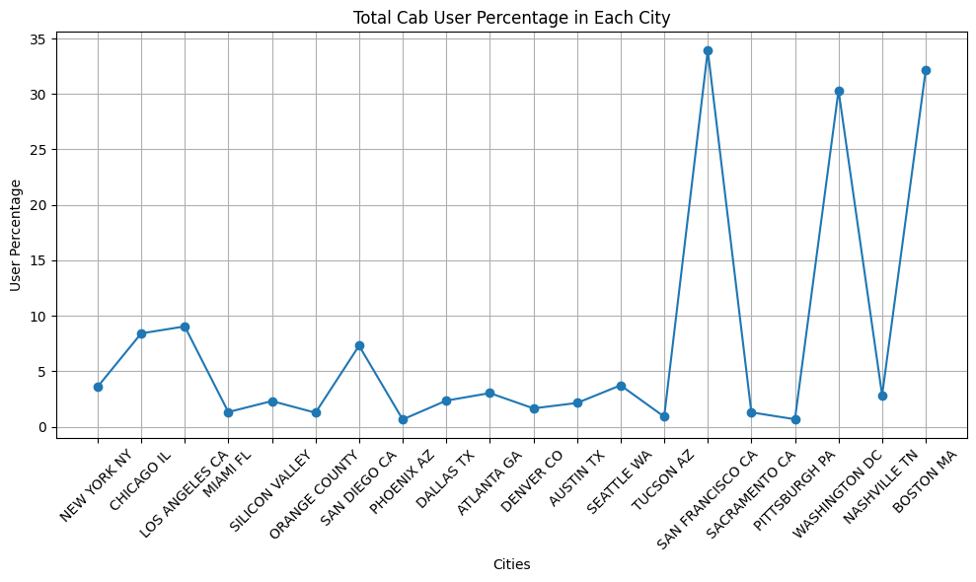
City wise Total Cab User Analysis
Based on user percentage, investing in cab services in cities like New York, San Francisco, and Washington DC offers the most promising market potential and customer base for XYZ firm.

Slide 13
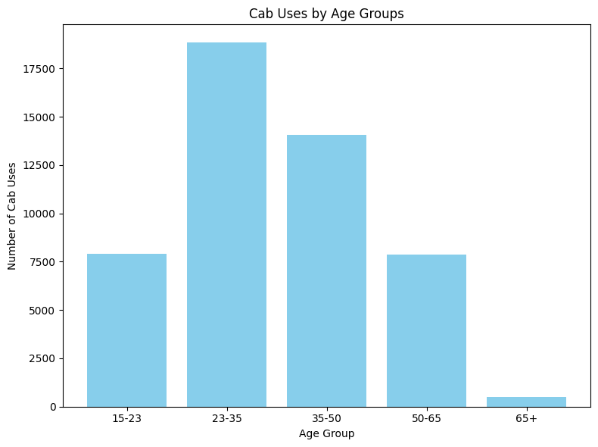
Cab Usage by Age Groups
The age group of 23-35 accounts for the highest cab usage with 18,837 rides.
Followed by the 35-50 age group with 14,084 rides.
Age groups 15-23 and 50-65 also contribute significantly with 7,903 and 7,855 rides respectively.
The 65+ age group shows the lowest cab usage with 492 rides.
Tailoring marketing strategies to target the age groups with the highest cab usage could optimize XYZ's investment impact.

Slide 14
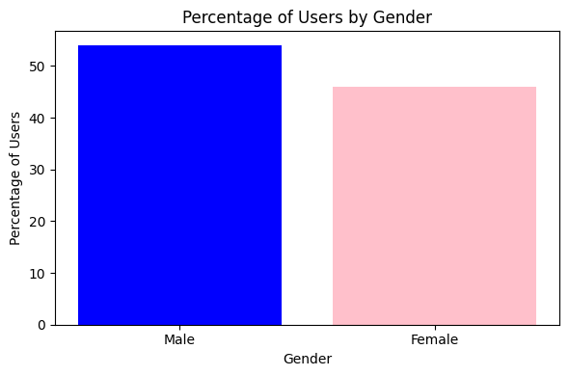
Gender-Based Cab User Percentage Analysis

Slide 15
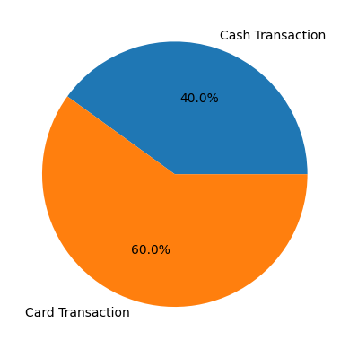
Transaction Mode Analysis
Profit Analysis
60% of cab transactions are via cards, signaling a preference for electronic payments.
Cash transactions make up 40% of total transactions, highlighting the need to cater to both payment methods.
XYZ can invest in fintech for improved digital payment experiences and target marketing to boost card usage.
Understanding cash transaction patterns can guide service enhancements.

Slide 16
Recommendations
1. Total Profitability: Yellow Cab's total profit is $44,020,373.17 and Pink Cab's total profit is $5,307,328.32. This reflects superior cost management and market dominance, making Yellow Cab the preferred investment with a potential 8x higher return.
2. City-wise Profit: In key cities like New York and Chicago, Yellow Cab's profits exceed Pink Cab's by over $25 million and $2.75 million respectively. Such substantial differences highlight Yellow Cab's stronger revenue potential and market share.
3. Cost-Benefit Analysis: Despite higher per kilometer prices and costs, Yellow Cab's larger ride volume ensures competitive profitability. For instance, while Pink Cab may have lower average prices and costs, Yellow Cab's higher profit per ride translates to better returns.
4. Market Potential: Cities like New York, San Francisco, and Washington DC boast high user percentages, indicating strong market demand. Investing in these cities offers significant growth opportunities and access to a large customer base.
5. Targeted Marketing: Focusing on age groups with the highest cab usage, such as the 23-35 and 35-50 demographics, can optimize ROI. For instance, tailoring marketing strategies to these age groups, which contribute over 18,000 and 14,000 rides respectively, can maximize engagement and conversion rates.
Investing in Yellow Cab promises higher profitability and market dominance, particularly in cities like New York and Chicago. Its strong revenue potential, despite higher costs, positions it as the optimal choice for XYZ's investment.

Slide 17
Thank You

